Slide 1
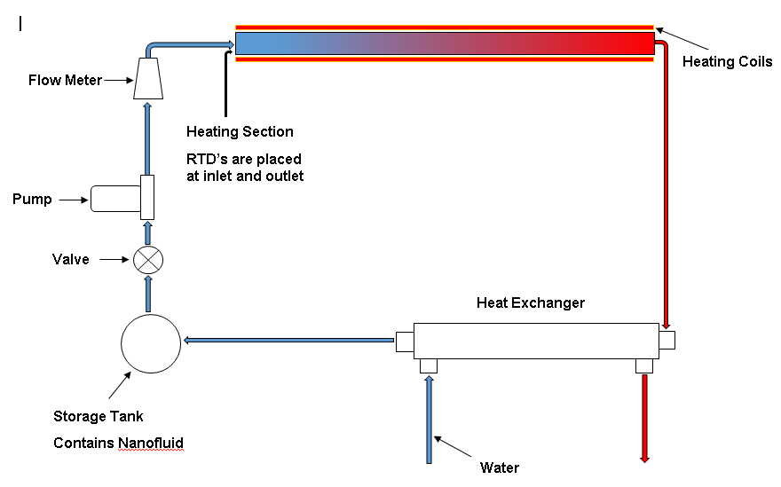
Experimental Setup

Slide 2
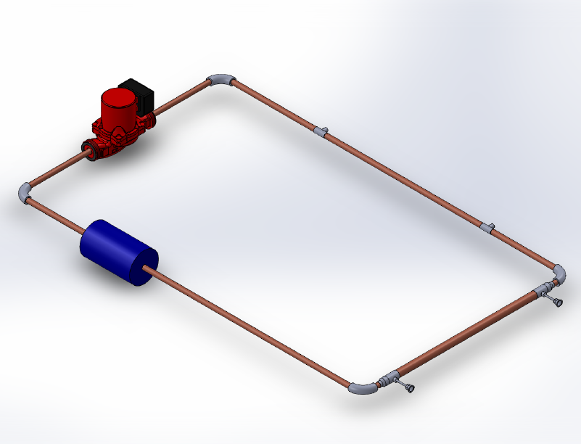
Final Design (39inx21.906inx.5in)
46/64
Pump
Reservoir
RTD
RTD

Slide 3
Manufacturability
51/64
Manufacturing Process
Ordering Supplies
Pump
Copper pipes
Thermocouples
Flowmeter
Valves,etc.
Inspection
Machining
Lathing
Possible Milling
Threading
Welding
Further Inspection/Testing
Cleaning/ Packaging

Slide 4
52/64
Manufacturability:
Assembly Process:
Pipelining
Copper piping
Elbows
Heating tape
Concentric Pipes (Heat Exchanger)
½” & ¾” diameter pipes
Reducers
Reservoir
2ft. x 3ft. nanofluid accumulator
Miscellaneous(extra materials needed)
Thermocouples or RTDs
Flowmeter

Slide 5
Manufacturability:
53/64
Design for Manufacturing:
Material
Copper
Design form
Circular piping
9’x6’ rectangular frame
Pipe connection
Threading
Welded

Slide 6
Design Validation

Slide 7
Preliminary Test Protocols
54/64
Run system for 10-15 minutes with no particles.
Check if unit is in proper position.
Check for proper functioning
Pump
Flowmeter
Heating tape
Reservoir overflow
Thermocouples
No leakage in the system
Run system with only water for an entire day.
Reinspect system for damages during test run.
Further inspect the entire system, for signs of failure:
Pump wear
Pipe leakage
Measurement system failure.

Slide 8
Test Protocols
55/64
Procedures
Fill the reservoir with nanofluid.
Turn on heating tape and allow it to reach steady state.
Start pump, and allow the system to run.
Take data on the second cycle and check to see if it makes sense.
If so, test with
Different nanoparticles sizes
Various temperatures
Record data.
Item is ready to shipped out into the market and business.

Slide 9
Safety Analysis
57/64
Design and failure modes:
Nanofluid-pump wear
Improper welding
Pump malfunction
Reservoir leakage
Tolerance
Pipe diameter

Slide 10
Safety Analysis DFMEA
58/64
Failure Mode | Label | Severity | Frequency | Easily Found | Rank Factor
Nano fluid pump wear | FM1 | 4 | 5 | 2 | 40
Improper Welding | FM2 | 3 | 3 | 5 | 45
Pump malfunction | FM3 | 5 | 1 | 5 | 25
Reservoir Leakage | FM4 | 5 | 1 | 4 | 20
Tolerance | FM4 | 5 | 1 | 1 | 5
Total |  |  |  |  | 135

